Slide 1
TIBCO BusinessEvents Rule Templates
Update – Feb 2011
Pranab Dhar, Suresh Subramani
Quantum Leap R&D
This document (including, without limitation, any product roadmap or statement of direction data) illustrates the planned testing, release and availability dates for TIBCO products and services. This document is provided for informational purposes only and its contents are subject to change without notice. TIBCO makes no warranties, express or implied, in or relating to this document or any information in it, including, without limitation, that this document, or any information in it, is error-free or meets any conditions of merchantability or fitness for a particular purpose. This document may not be reproduced or transmitted in any form or by any means without our prior written permission.
Notes:
Welcome. Thank you for the opportunity to tell you more about TIBCO and how we can help you. Let me introduce my team….

Slide 2
Disclaimer
This presentation (including, without limitation, any product roadmap or statement of direction data) illustrates the planned testing, release and availability dates for TIBCO products and services. This document is provided for informational purposes only and its contents are subject to change without notice. TIBCO makes no warranties, express or implied, in or relating to this document or any information in it, including, without limitation, that this document, or any information in it, is error-free or meets any conditions of merchantability or fitness for a particular purpose. This document may not be reproduced or transmitted in any form or by any means without TIBCO’S prior written permission.
THIS PRESENTATION CONTAINS PRIVILEGED AND CONFIDENTIAL INFORMATION PROVIDED TO OR FOR THE BENEFIT OF TIBCO SOFTWARE INC. AND ITS AFFILIATES. ANY INFORMATION CONTAINED IN THIS PRESENTATION IS FOR THE SOLE USE OF THE INTENDED RECIPIENTS. ANY REVIEW, COPYING OR DISTRIBUTION OF THIS PRESENTATION BY OTHERS IS STRICTLY PROHIBITED.

Slide 3
Design Elements
BRMS Rule Template is very similar to a Virtual Rule Function. In that it has the structure of the Rule but no execution logic – both in condition and action.
The design elements of the Rule templates revolves around the following concept
Rule Template Definition done inside BE Studio
Rule Template Instance created in Web Studio
Deployment Methodology
Execution Semantics

Slide 4
Roles and Responsibility
Developer Role :
Has the responsibility of defining Rules in BE Studio
Has the responsibility of creating the Rule Templates in BE Studio
Has the responsibility of providing the right functions and computed variables in Template for later use
Business User/Analyst Role
Creates a Rule Instance from the Rule Template
Saves it, Test it, Provides policies around its execution
Submit for Approval/Deployment.
Administrator Role
Verifies consistency in project
Build Ears, and hot deploys to engine.

Slide 5



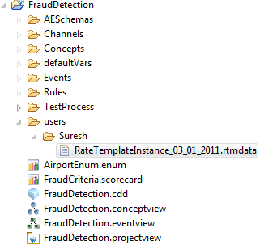
Workflow
Developer
Developer
Business Analyst
BRMS Admin
BRMS UI
Approve and Deploy
Rule Template
Studio
Rule Instance
Scope
Metadata
Conditions
Set operations
Create Operations
Rulefn calls
Build EAR
Save user RT instance metadata
Update CDD file
Pre-condition Var declaration
EAR file archive
Runtime
Action context
Set
Create
Rulefunctions
Bar file archive
BRMS Check-in
Load user’s rule template metadata and deploy rule instance
Exceptions
JAR archive
Rule Template class
Rete
Template Rule instance
Working Memory

Slide 6
Assumptions
Template rules are implemented and instantiated by Business users.
Templates provide a highly constrained scope of implementation.
Template rules have no complex statements.
Template rules have no conditional branching.
Template rules have simple assignments.
Template rules have no cache statements.

Slide 7
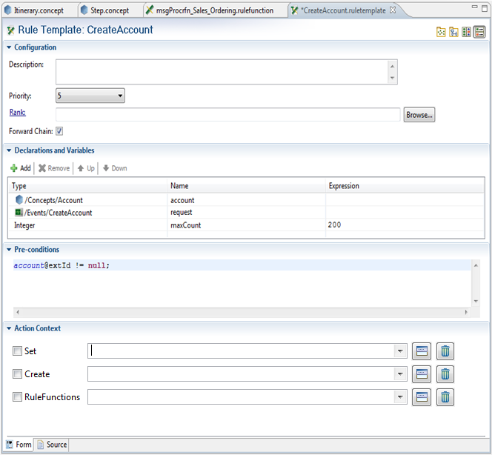
Template Rule Editor

Slide 8

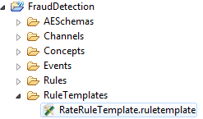


Runtime Semantics
Rule
Template
Build EAR
EAR file archive
Bar file archive
JAR archive
Runtime
Developer
Rule Template class
Create Rule
Instances
Save
Instance
metadata
Submit for Approval
BE classloader loads rule template class.
BE rule deployer ignores template rules
Business User
Rule deployer passes condition & action metadata and instantiates a deployable rule.
Hot deploy EAR file archive
Add metadata to project
Add instance to CDD
Build EAR
Bar file archive
Approve
& Deploy
JAR archive
Rule instance is deployed in the Rete network
Rule Template class
Admininstrator
Template Rule instance
Working Memory

